Slide 1
Drivers of Handle for Arlington Park(AP)

Slide 2
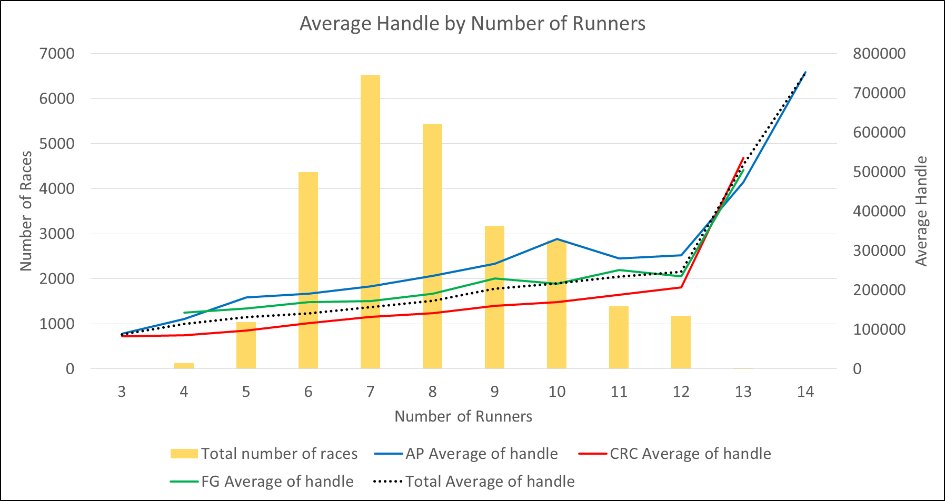

Slide 3
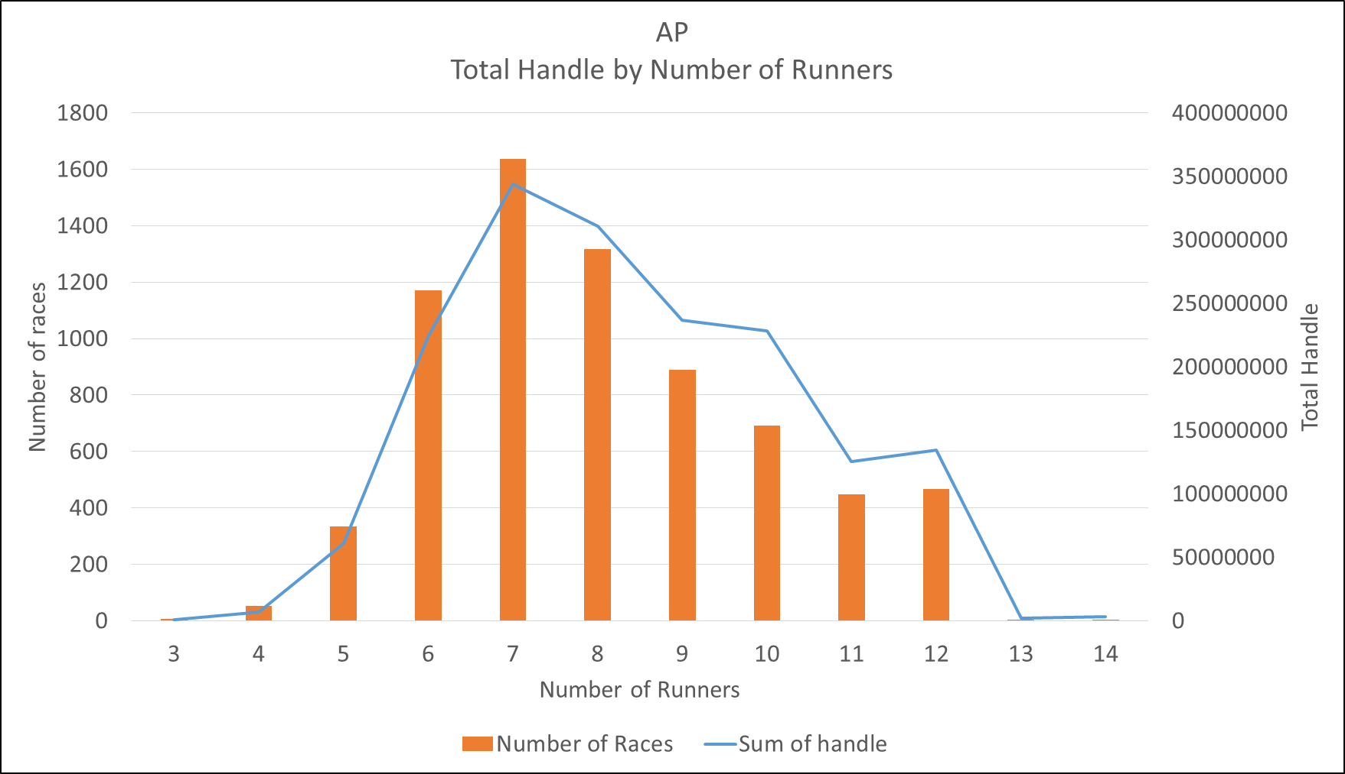

Slide 4
Number of Runners
Highest number of races are run where number of runners are 7.
Average Handle is highest for 10 runners.
On average higher number of runners leads to higher handle bet. So, more races should be run for 8,9 and 10 runners.

Slide 5
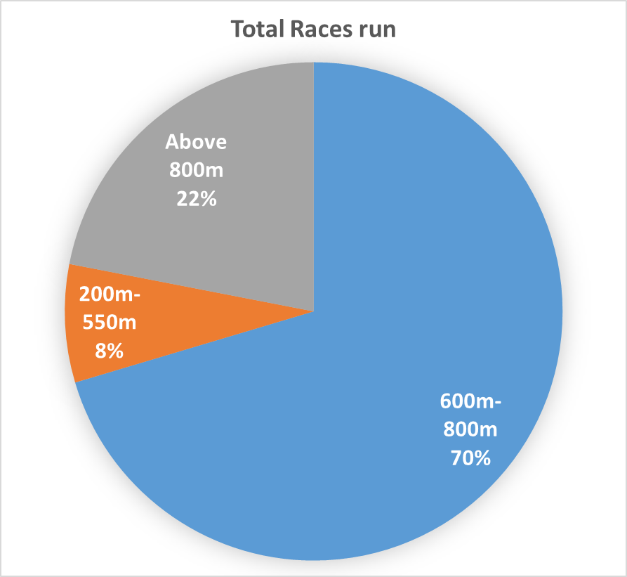
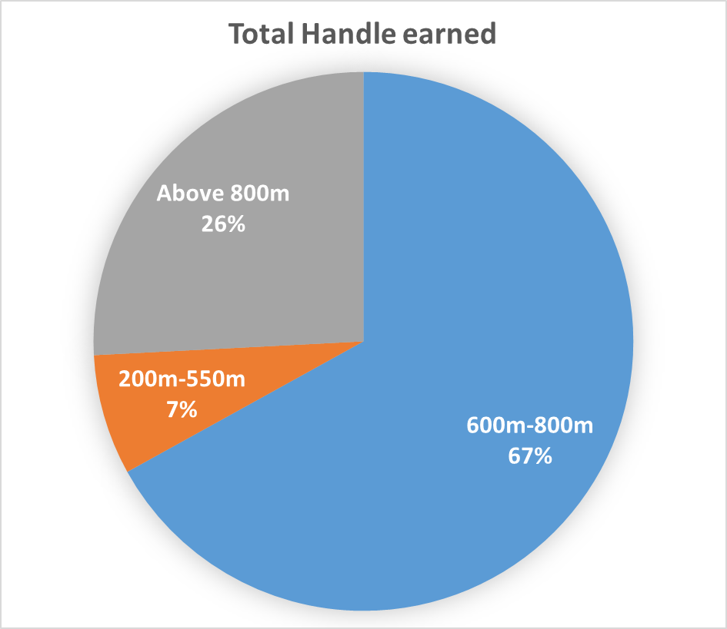
Race Distance Percentage of Handle and Races
Larger the race distance, higher the handle earned.

Slide 6
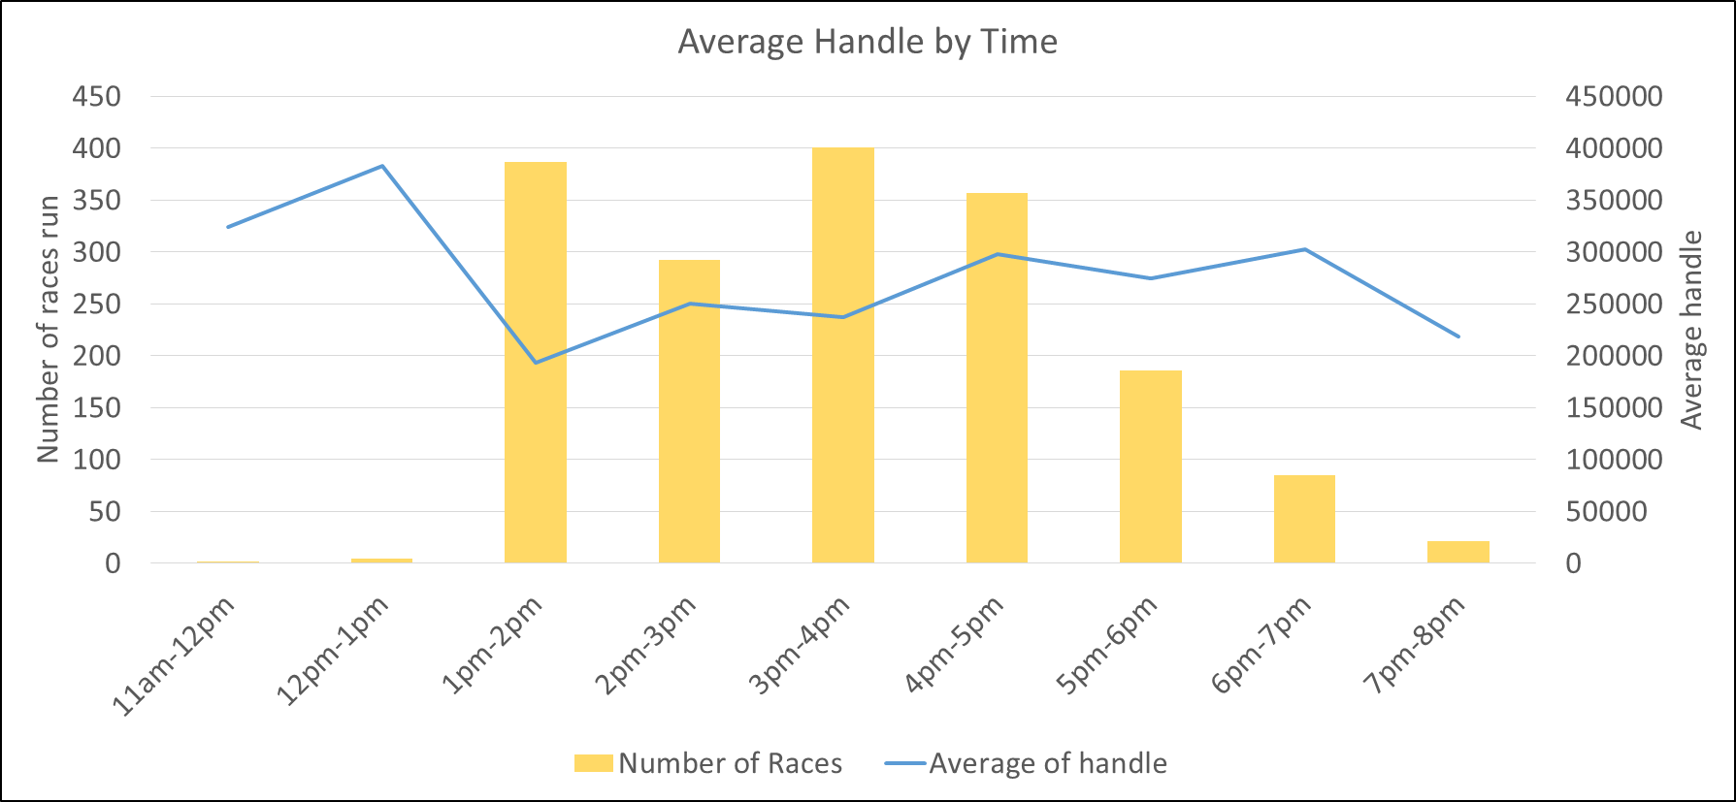
Average Handle by Time
The average handle is higher for the races ran during 3pm-7pm. Therefore, more races should be ran during this period.

Slide 7
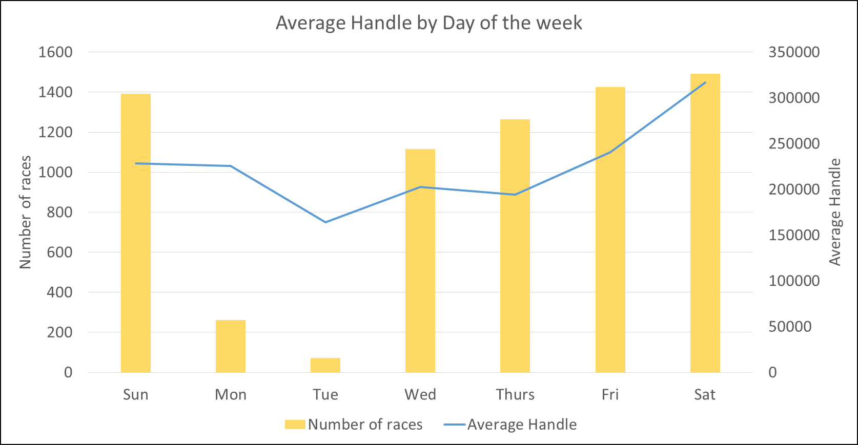

Slide 8
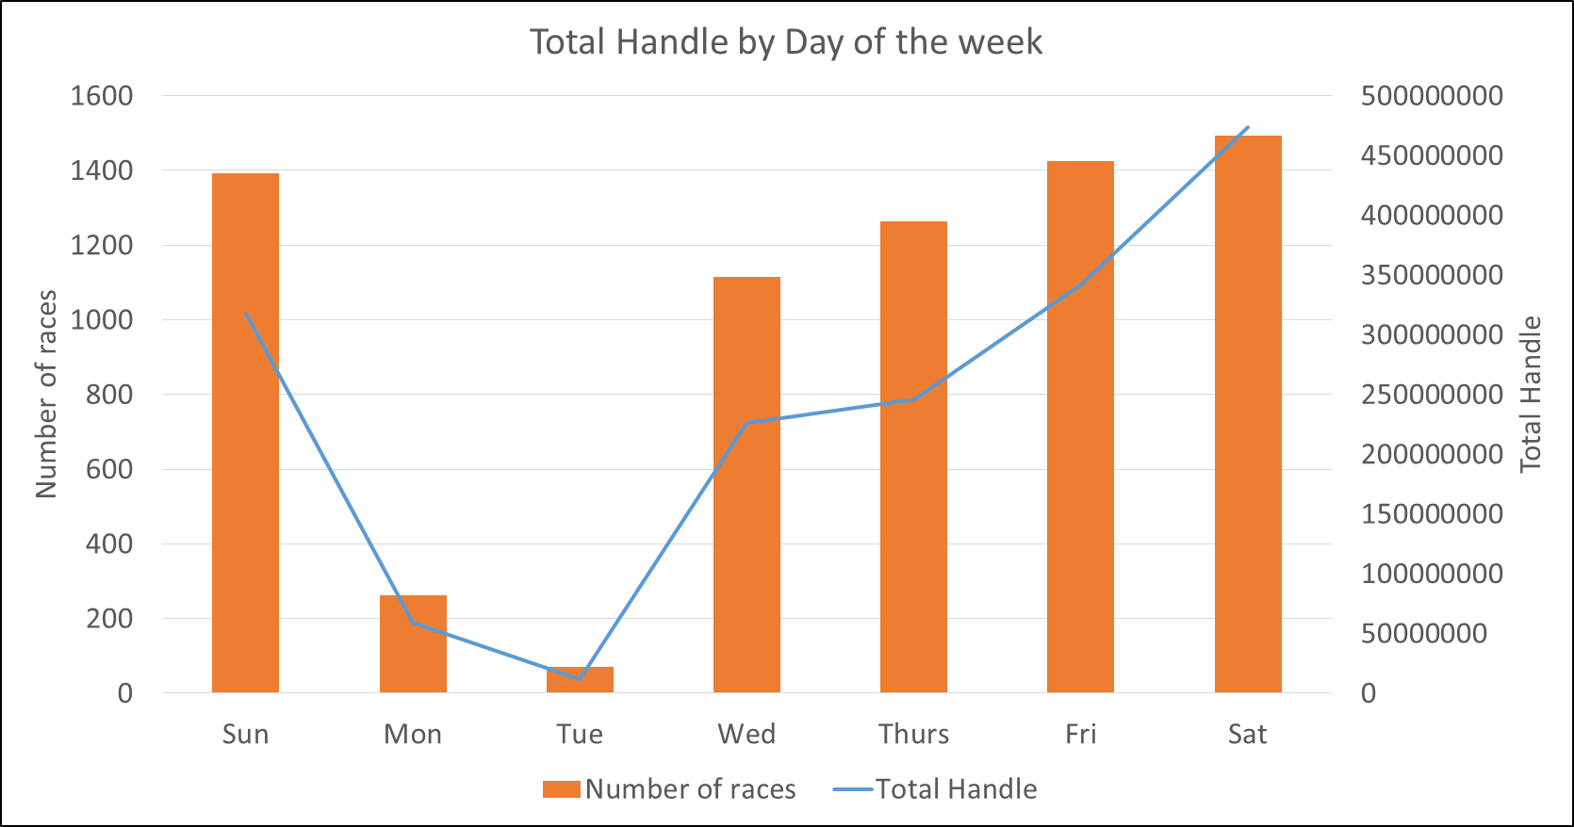

Slide 9
Handle by Day of the week
Saturdays are the most beneficial days of the week. Maximum handle is earned of Fridays and Saturdays.
Tuesdays have less number of races run and average handle drops on these days.

Slide 10
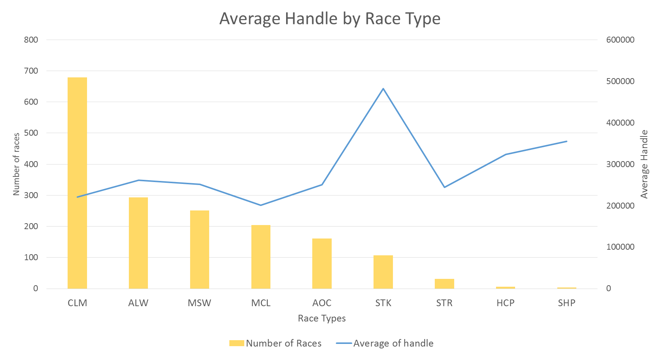

Slide 11
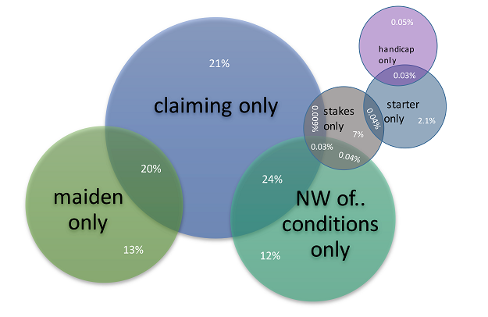
Fig - Venn diagram showing number of races by race types in percentage

Slide 12
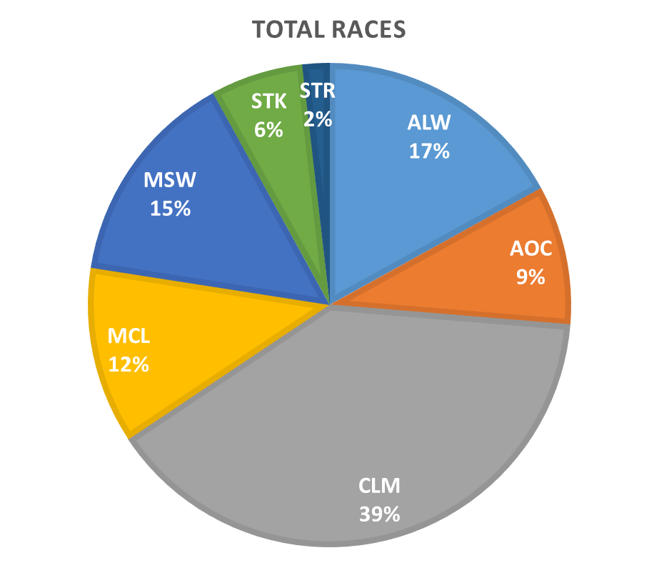
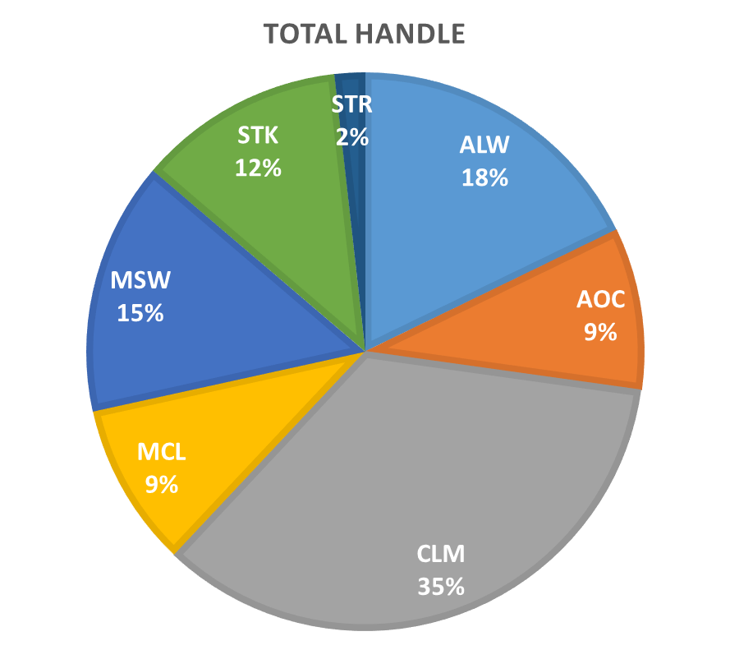
Types of Races Percentage comparison for handle and races

Slide 13
Interpretation for the Type of Races pie charts
The total percentage of races run for the race type Stakes(STK) is 6 % of overall races. Whereas the handle generated is twice that of expected, i.e. 12 % of total handle.
For the race type Allowance (ALW) the handle contributes to 18 % of total handle for 17 % of total races run.
We can see that for the Maiden Claiming(MCL) the handle contributes to 9 % of total handle for 12 % of total races run.
For the race type Claiming(CLM) the handle contributes to 35% of total handle for 39% of total races run.
Recommendation:
More number of races should be run for the following category: Stakes, Allowance.
Number of races run for the following categories should be reduced: Maiden Claiming and Claiming.
Colour coded:
Red: Negative impact
Blue: Positive impact

Slide 14
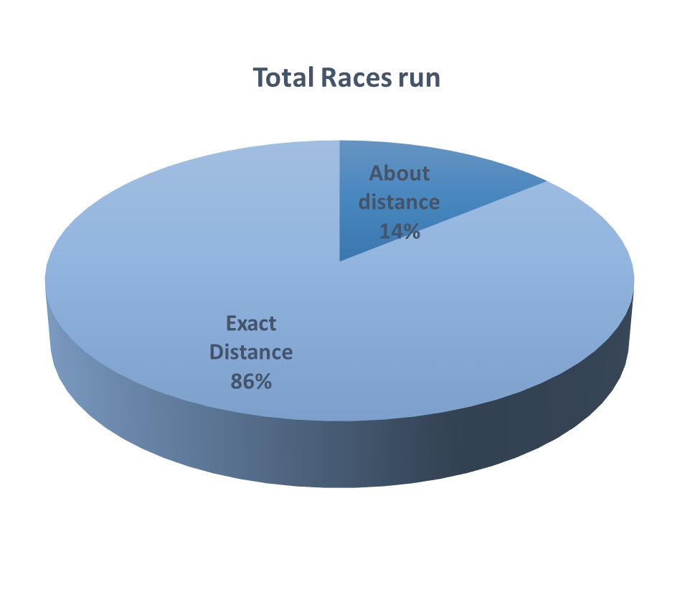
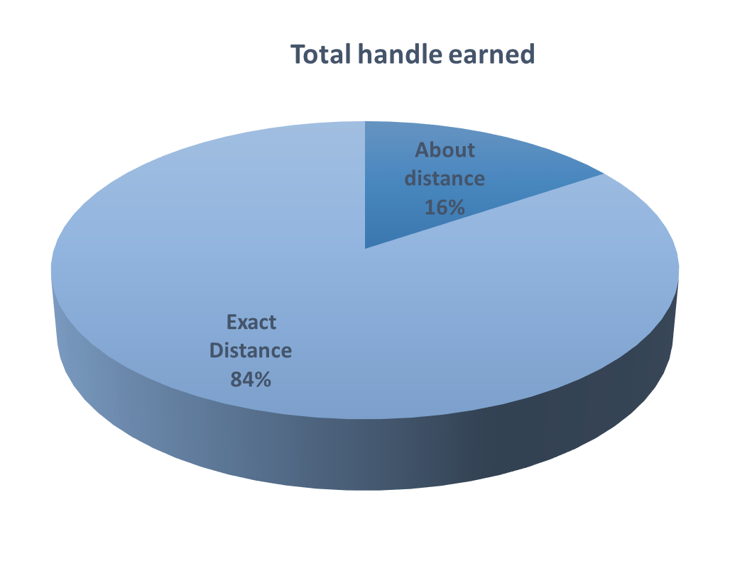
About Distance Indicator
It is better to keep the distance indicator for about distance rather than exact distance.

Slide 15
Track Surface Percentages of Handle and Races
The handle earned on the track surface Turf is 32% of overall handle, while the percentage of races run on turf is only 26% of all races.
The handle earned on Dirt is 68% of total handle, whereas 74% of all races are run on Dirt surface.
This shows that to improve the handle, it is clearly better to run more number of races on the surface Turf.

Slide 16
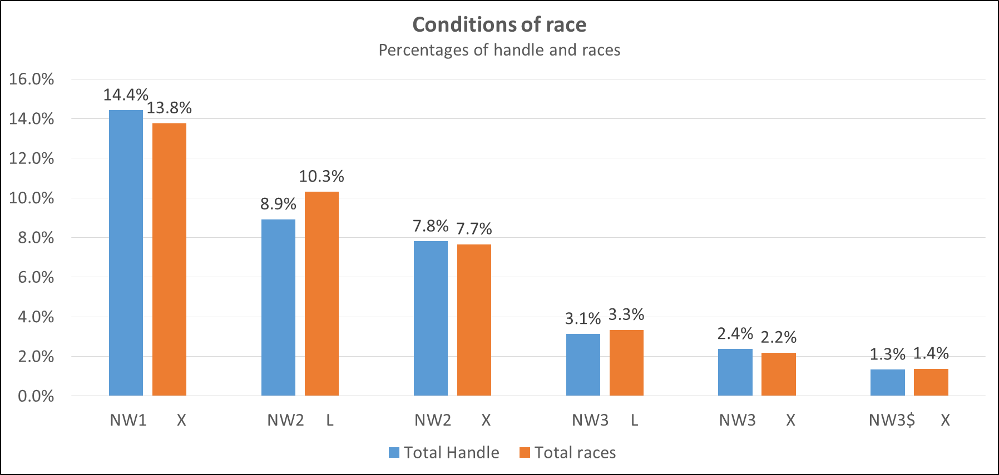
The graph shows that maximum handle contribution comes from ‘Non winner of X conditional races’ like claiming or maiden races .

Slide 17
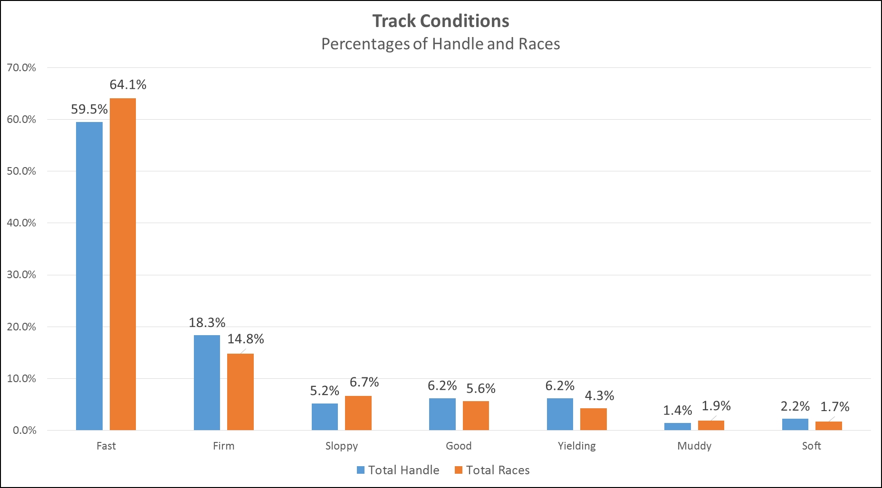

Slide 18
Track Conditions
59% of the handle is earned from fast tracks , however it is still low considering the fact that 64% of races are run on fast track. So, number of races run on fast tracks should be reduced.
Sloppy race tracks earn 28% less handle than expected.
Muddy race tracks also earn 35% less handle than expected.
Races run on firm race track contribute to 18% of the total handle and earn 23% more handle than expected.
Yielding and Good race tracks each contribute 6.2% of the total handle, however the races run are only 4.3% and 5.6% respectively. So, it would be better to have more races run on these tracks.
Results:
Firm, Yielding, Good and Soft race tracks contribute more handle on average.
Fast, Sloppy and Muddy race tracks contribute less handle on average.
Colour coded:
Red: Negative impact
Blue: Positive impact

Slide 19
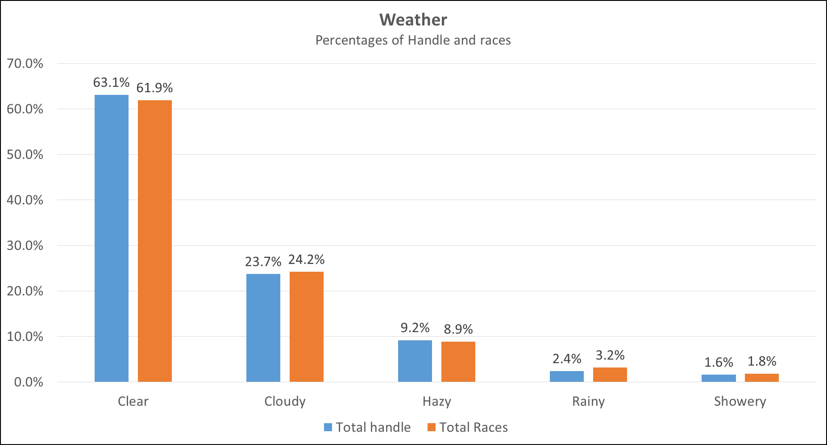

Slide 20
Weather Impacts
Clear and Hazy weather are best suited for races. Both of them lead to higher handle being bet per race.
Cloudy, Rainy and Showery weather are not suited for higher bet on handle.

Slide 21
Predictive algorithm
Handle = (27805*Holiday) + (37661*Friday)+ (64825*Saturday) +
(123096*Starter Stakes) +(65178*race_number3 )+ (186223*race number11) +
(-52855*Dirt Track) + (-30623*About Distance)+
(25523*Month July)+(89667*Month Aug)+(41513*Month September) +
(-22552*Distance 500m) + (-18688*Distance 850m) + (-17148*Distance 900m)+ (369288*Distance 950m) + (553007*Distance 1000 m)+
(-60123*number of runners4 ) + (18857*number of runners7) + (40166*number of runners8) + (48609*number of runners9) + (91606*number of runners10) + (74651*number of runners11) + (85835*number of runner12) +
(-32333*Sloppy Track) + (-45751*Soft track) + (-25345*Hazy Weather)

Slide 22
Parameters affecting Handle
Colour coded:
Red: Negative parameters
Blue: Positive Parameters

Slide 23
Simulation Using Regression Equation
Calculating handle for the best conditions:
Month: August Race Condition : Starter Stake Track Condition: Firm Weather: Clear Day :Saturday Number of runners:10 Distance:1000m Surface: Turf
Average Handle during August= $ 305,429
Handle predicted using equation= $1,263,315

Slide 24
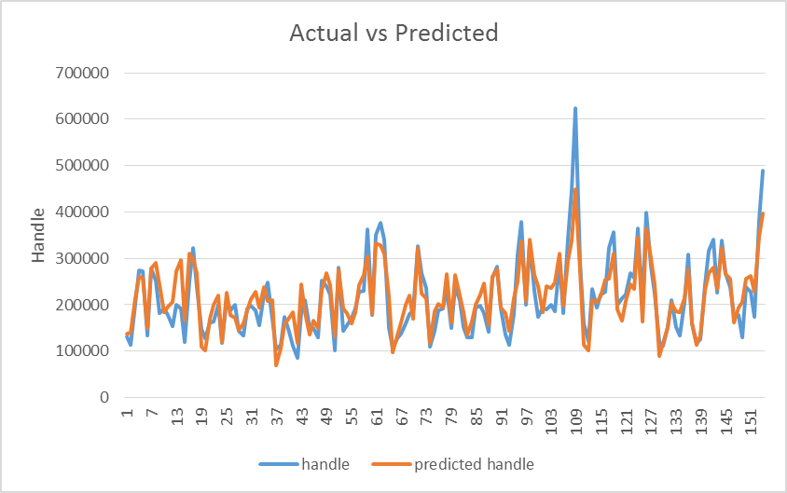
Actual vs. Predicted Handle

Slide 25
Thank You

